Slide 1
Algorithm Independent Techniques
The Philosophy of Pattern Recognition
No Free Lunch
The Ugly Duckling
Occam’s Razor
Algorithm Independent Techniques
  Jackknife
  Bootstrap
  Bagging
  Boosting
  Cross validation

Slide 2
The Philosophy of Pattern Recognition
Assuming that we have no prior information about a particular classification problem, which classifier shall we use?
Is there a classifier that is better than / superior to all other classifiers that we should use?
Is there any reason to prefer one classifier over another? When would you use which classifier, why?

Slide 3
The Philosophy of Pattern Recognition
How about features? For a given problem, with no prior information, is there a set of features that are better than others? What features shall we use? Why?
Given two classifiers that perform equally well (or poor) on a given training dataset, is there a reason to choose one over the other? Which one would you choose?

Slide 4
No Free Lunch
No Free Lunch Theorem: If no prior information in available about a classification (function approximation) problem, no classifier is better than any other classifier, including random guessing, on all such classification (function approximation) problems.
A classifier can only be better in approximating “some” of these functions, and even then, it has to be worse on some other type of functions. In fact, for “some” of these functions, the random guessing is guaranteed to perform better than any other classifier.
Consequently, there is no reason to choose one type of classifier over another. Hence, no free lunch!

Slide 5
The Ugly Duckling
The Ugly Duckling Theorem: Just like there is no reason to choose one type of classifier over another (in the absence of prior knowledge), there is also no reason to choose one set of features over another !!!

Slide 6
Occam’s Razor
Given two classifiers with identical performance on a given training dataset, we DO have a reason to choose one over the other…..!
This rule is interpreted to mean that
  the simplest of two or more competing theories is preferable , an explanation for unknown phenomena should first be attempted in terms of what is already known.
Entities should not be multiplied beyond necessity…!
Notes:
如无必要，勿增实体

Slide 7
Occam’s Razor
Given two classifiers with identical performance on a given training dataset, we DO have a reason to choose one over the other…..!
The simpler classifier with fewer degrees of freedom is more likely to perform better on a previously unseen (test) dataset, as it is less likely to suffer from overfitting problems.
But…given the free lunch theorem , that is , there is no reason to pick any one classifier over another, why should we pick the simpler classifier? Is overfitting avoidance more powerful than the free lunch theorem??? Paradox…?

Slide 8
The Paradox of Pattern Recognition
Then why should we be researching on better pattern recognition algorithms, in the first place, if there is no such thing as a “better classifier” ?
Of course, this mentality also allows us to be very skeptical whenever someone comes up with a new algorithm, claiming it to be the next best thing since slice bread (= multilayer perceptron…)
So, what does a “pattern recognition professional” to do?

Slide 9
The Essence of Pattern Recognition
The science of pattern recognition is mostly concerned with choosing the most appropriate algorithm for the problem at hand
This requires some a priori knowledge – data distribution, prior probabilities, complexity of the problem, the physics of the underlying phenomenon, etc.

Slide 10
The Essence of Pattern Recognition
The free lunch theorem tells us that – unless we have some a priori knowledge – no classifier is any better than the other. However, given some a priori information, certain classifiers may MATCH better with certain type of problems.
The main challenge of the pattern recognition professional is then, to identify the correct match between the problem and the classifier! …which is yet another reason to arm yourself with a diverse set of PR arsenal !

Slide 11
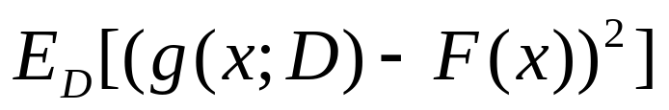
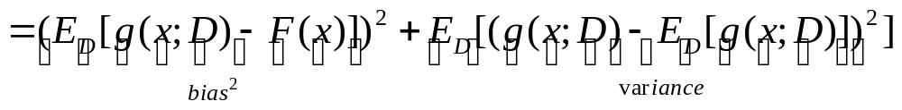
Bias & Variance
Two measures for evaluating the match between a classifier and a classification problem are bias and variance.
Function F(x), sample set D, regression function g(x;D)

Slide 12
Bias & Variance
Bias measures the accuracy / quality of the match.
High bias ➔ Poor match
Variance measures the precision / specificity of the match
High variance ➔Weak match
So one must choose a low bias (that generally gives good results) and low variance algorithm (that the results don’t change much with the training data), However, for a given error criterion, bias and variance obey a conservation law !

Slide 13
Bias – Variance Dilemma
An algorithm with lots of free parameters to adapt to the problem➔most likely to learn the problem ➔ low bias (good performance).
However, an algorithm with many different parameters is likely to produce different results if trained with a different dataset ➔ high variance.

Slide 14
Bias – Variance Dilemma
An algorithm with few adjustable parameters ➔ will not change much from one to another training dataset ➔low variance
However, such an algorithm will not have good results ➔ high bias
The only way to reduce bias and variance at the same time is to have a prior knowledge !!!

Slide 15
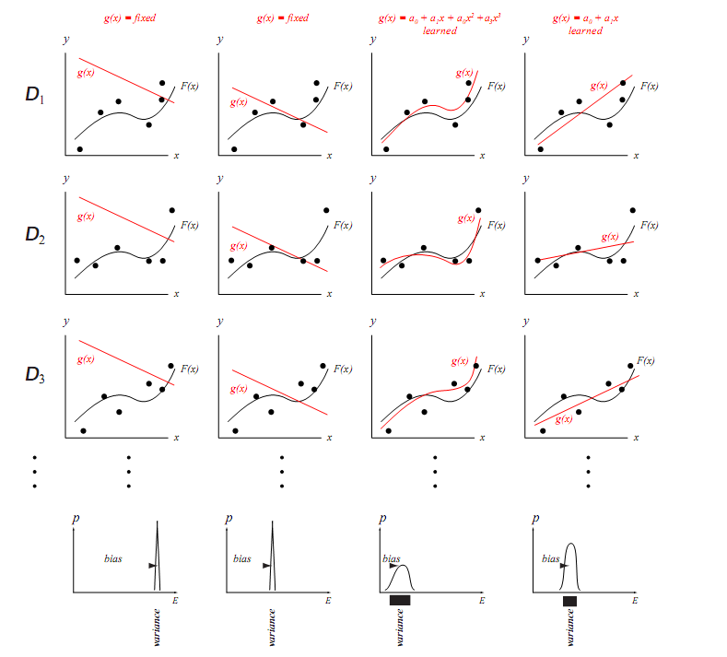
Bias – Variance Dilemma

Slide 16
If there is no free lunch…
OK, so there is no free lunch: There is no “superior” classifier that consistently performs better then others.
But is there something we can do to improve the classification performance of a classifier?
If so, can we use a similar technique on any classifier? All classifiers?

Slide 17
Algorithm Independent Techniques
Based on generating multiple classifiers, using different combinations of the training data
Different combinations of the data are obtained through resampling techniques
  Resampling for estimating statistics
    Jackknife
    Bootstrap
  Resampling for classifier design
    Bagging
    Boosting
    Cross validation

Slide 18
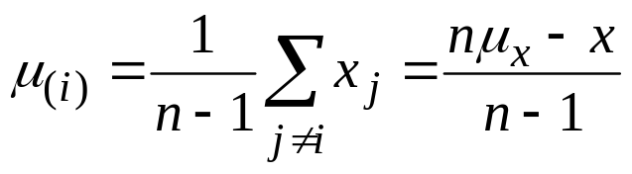
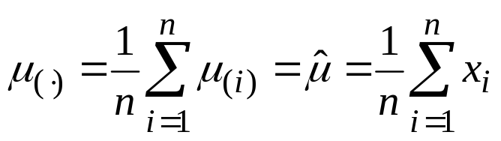
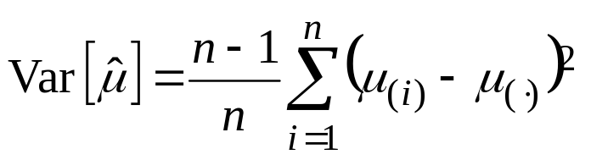
Jackknife
Leave-one-out: Any statistical operation that is performed by leaving one example out of the sample
  Leave-one-out mean:
  Jackknife estimate of the mean:
  Jackknife estimate of the variance of μ(.) :

Slide 19
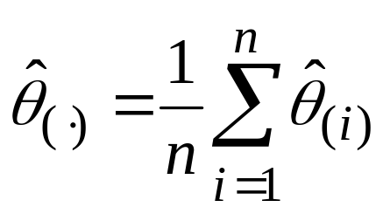
Jackknife
The advantage of expressing variance as a jackknife estimate is that it can be applied to any statistical estimator (median, mode, 25th percentile, etc.)
So the Jackknife estimate of any statistical parameter, say θ, is

Slide 20
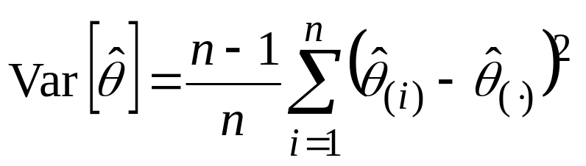
Jackknife
and the Jackknife estimate of the above estimate’s variance is
which provides us with a measure of certainty in the original estimate
  (θ can be mean, median, kurtosis, mode, confidence, etc.)

Slide 21
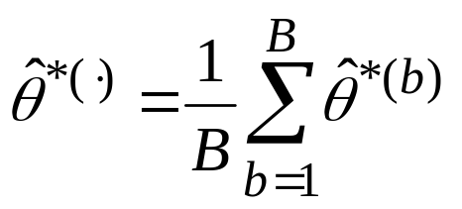
Bootstrap
A bootstrap dataset is a set created by selecting n points at random from a training data D, with replacement (points can be duplicated)
Since the original data consists of n to begin with, a bootstrap dataset is almost always guaranteed to have multiple copies of certain instances
A bootstrap estimate of a parameter is computed by obtaining the mean of the parameters estimated from B such independent bootstrap datasets:
Estimate of the bootstrap sample b

Slide 22
Resampling for Classifier Design
So how do we use these concepts for pattern recognition and classification?
Design multiple classifiers, using various sampling of the training data, and use some appropriate procedure to combine the outputs of these multiple classifiers ➔ Ensemble of Classifiers
Appropriate procedure…?

Slide 23
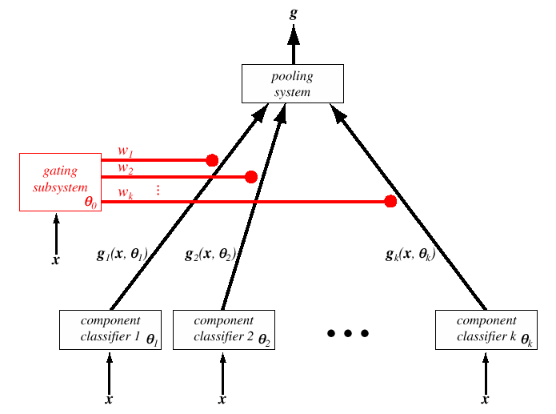
Mixture of Experts/Ensemble of Classifiers
Final decision
Combines the outputs of individual “experts” through some appropriate combination scheme
The weighting system: Assigns a confidence vote to each classifier. Can be even another classifier
Decision rule generated by classifier k, e.g., linear discriminant function, or a class information
Parameters of
classifier 1, e.g.,
weights of a NN
Parameters of
classifier k.

Slide 24
Diversity
Would this work? When would it work? Why should it work…?
Generally, to get a good ensemble, the base Classifiers should be as more diverse as possible.
Diversity
  Subsampling the training examples,
  manipulating the attributes,
  manipulating the outputs,
  injecting randomness into learning algorithms
Notes:
数据样本扰动
数据样本扰动通常是基于采样法，
输入属性扰动
属性子空间提供了观察数据的不同视角，对包含大量冗余属性的数据，在子空间中训练个体学习器不仅能产生多样性大的个体，还会因属性数的减少而大幅节省时间开销；
输出表示扰动
基本思路是对输出表示进行操纵以增强多样性.可对训练样本的类标记稍作变动；也可对输出表示进行转化；还可将原任务拆解为多个可同时求解的子任务；
算法参数扰动
基学习算法一般都有参数需进行设置，例如神经网络的隐层神经元数、初始连接权值等，通过随机设置不同的参数，往往可产生差别较大的个体学习器.

Slide 25
Instability of a Classifier
A classifier is said to be unstable (or weak classifier) if minor changes in its parameters, such as the training data, results in a significantly different decision boundary.
The performance of the combination of such classifiers through majority voting can be shown to be better than any of the individual classifiers!

Slide 26
Bagging
Bagging ➔ Bootstrap Aggregation
  Bootstrap :Generate multiple versions of the training dataset by selecting n’<n samples from the dataset D.
  Generate a separate classifier with each “bootstrapped” dataset
  Combine the outputs of these classifiers using majority voting
  E.g. random forest
Notes:
Bootstrap Aggregation: 自助聚合

Slide 27
Bagging
Bagging not improve the bias performance but can reduce the variance
To reduce the bias classifier should be strong

Slide 28
Boosting
A procedure for improving –hence boosting – the classifier accuracy by combining multiple classifiers
Multiple classifiers are trained with – not bootstrapped – datasets, but strategically chosen subsets of the training data.
Many versions of the boosting algorithm: the most popular one is the AdaBoost (adaptive Boosting)
Most effective on weak classifiers, which do at least better than random guess on a given training data. The stronger the weak classifier, the less the impact of AdaBoost.

Slide 29
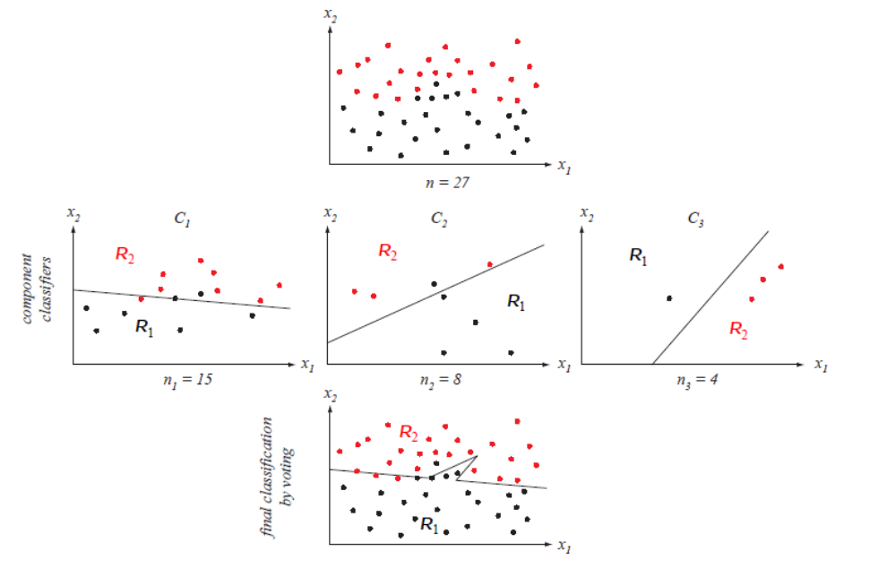
Boosting e.g.
Notes:
C1随机
C2：一半C1分类错，1半正确
C3：C1+C2判决结果不同

Slide 30
Boosting e.g.
First we randomly select a set of n1 <n points from the full training set D，D1
train the ﬂrst classiﬂer, C1, with D1
Now we seek a second training set, D2, that is the most informative, given component classiﬂer C1。Speciﬂcally, half of the patterns in D2 should be correctly classiﬂed by C1, half incorrectly classiﬂed by C1
train C2, with D2
Next we seek a third data set, D3，adding most informative patterns to it
For a given pattern ，if C1 and C2 disagree, we add it
train C3, with D3

Slide 31
Comparison of bagging and boosting
1. Resampling
  Bagging: bootstrap, boosting: strategically chosen
2. Weighting system
    Bagging: fixed, boosting: adaptive
3. Performance improving
  Bagging: variance, boosting: bias and variance
4. Classifier
    Bagging: strong, boosting: weak

Slide 32
AdaBoost
Create a discrete distribution of the training data by assigning a weight W_{k}(i) to each instance. Initially, the distribution is uniform, hence all weights are the same
Draw a subset from this distribution and train a weak classifier with this dataset
Compute the error, E, of this classifier on its own training dataset. Compute error weighting α_{k}

Slide 33
AdaBoost
Test the entire training data on this classifier:
  If an instance x is correctly classified, reduce its weight proportional to E
  If it is misclassified, increase its weight proportional to E
  Normalize the weights such that they constitute a distribution
Repeat until T classifiers are generated
Combine the classifiers using α_{k} majority voting

Slide 34
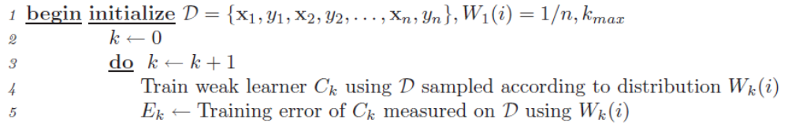
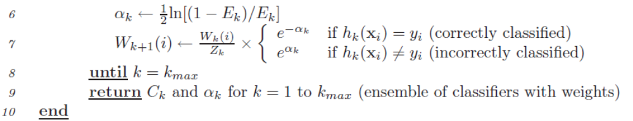
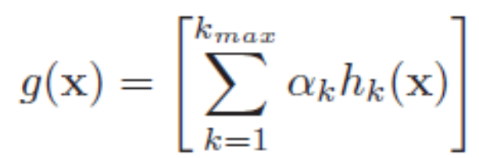
AdaBoost Algorethm
Classfier:
Notes:
Zk is simply a normalizing constant computed to insure that Wk(i) represents a true distribution,
αk 是E的减函数

Slide 35
AdaBoost performance
the training error of the strong classifier approaches zero exponentially
generalization performance is related to the margin of the examples, and that AdaBoost achieves large margins rapidly

Slide 36
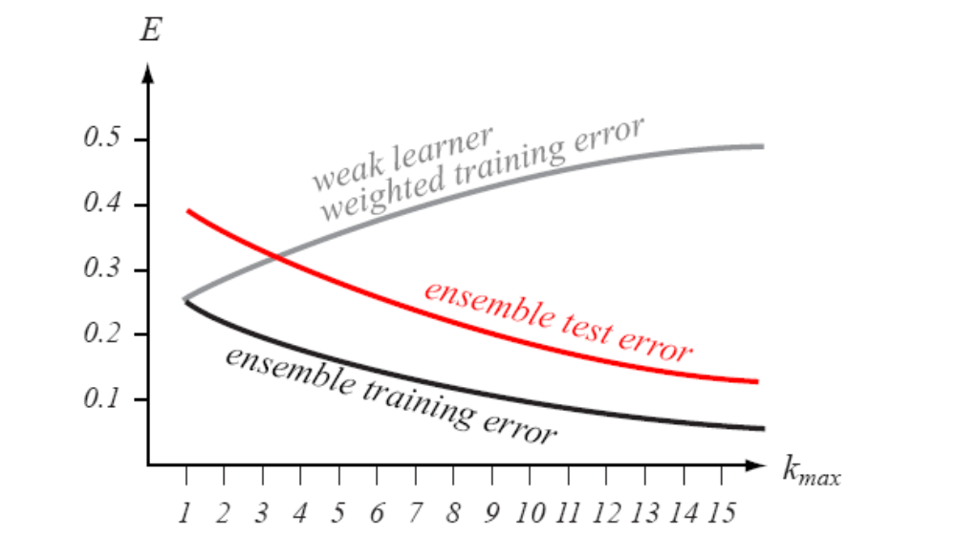
Notes:
泛化性能

Slide 37
Adaboost example: Face detection
Object detection framework: Given a set of images find regions in these images which contain instances of a certain kind of object.
Task: Develop an algorithm to learn an fast and accurate method for object detection.
Notes:
2001 iccv compaq

Slide 38
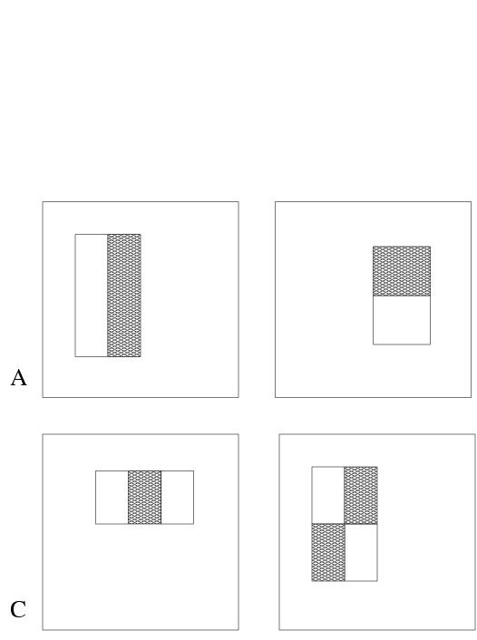

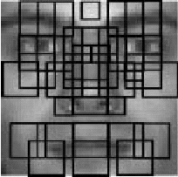




Definition of simple features for object detection
3 rectangular features types:
  two-rectangle feature type (horizontal/vertical)
  three-rectangle feature type
  four-rectangle feature type
Using a 24x24 pixel base detection window, with all the possible combination of horizontal and vertical location and scale of these feature types the full set of features has 49,396 features.

Slide 39
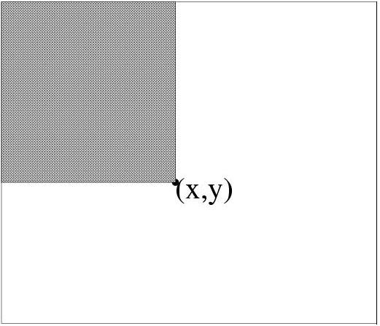

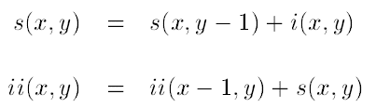
Integral image
Def: The integral image at location (x,y), is the sum of the pixel values above and to the left of (x,y), inclusive.
Using the following two recurrences, where i(x,y) is the pixel value of original image at the given location and s(x,y) is the cumulative column sum, we can calculate the integral image representation of the image in a single pass.

Slide 40
Integral image (cont’)
x
(0,0)
s(x,y) = s(x,y-1) + i(x,y)
ii(x,y) = ii(x-1,y) + s(x,y)
y
(x,y)

Slide 41
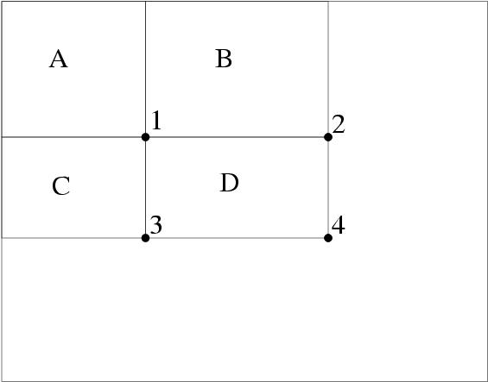
Rapid evaluation of rectangular features
Using the integral image representation one can compute the value of any rectangular sum in constant time.
For example the integral sum inside rectangle D we can compute as:
ii(4) + ii(1) – ii(2) – ii(3)

Slide 42
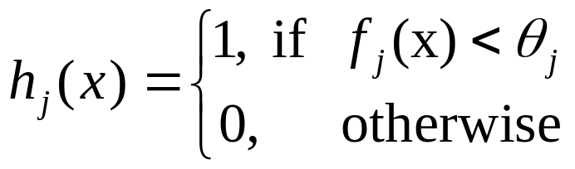

AdaBoost based classifier
negative examples
positive examples
Weak classifier
f_{i}
h(x) is the value of weak classifier， is threshold
， is feature value， is a Harr-like feature.

Slide 43
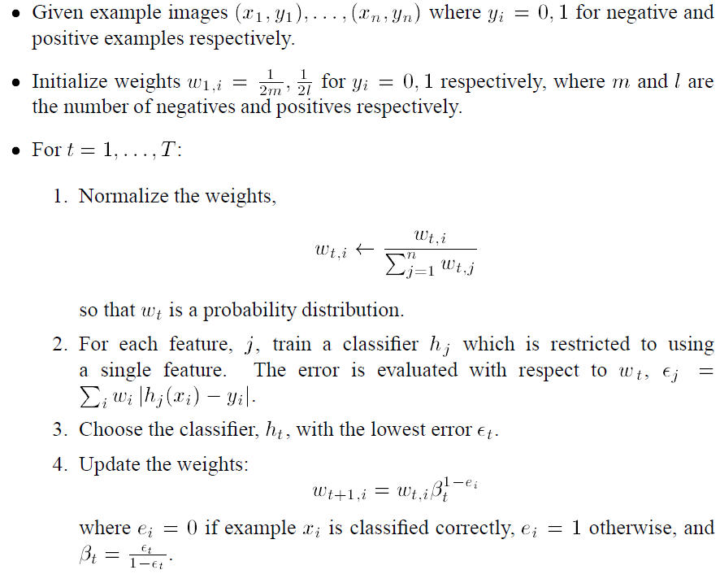
A variant of AdaBoost for feature selection

Slide 44
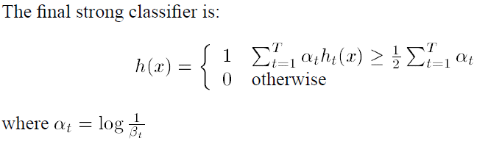
A variant of AdaBoost for feature selection

Slide 45
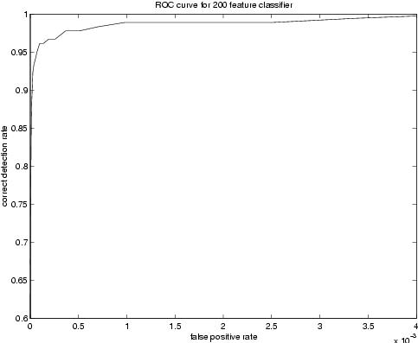
Performance of 200 feature face detector
The ROC curve of the constructed classifies indicates that a reasonable detection rate of 0.95 can be achieved while maintaining an extremely low false positive rate of approximately 10⁻⁴.
First features selected by AdaBoost are meaningful and have high discriminative power
By varying the threshold of the final classifier one can construct a two-feature classifier which has a detection rate of 1 and a false positive rate of 0.4.

Slide 46
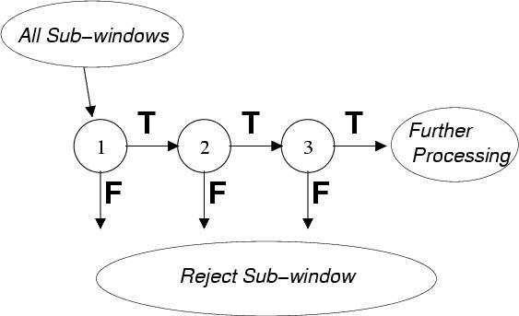
Speed-up through the Attentional Cascade
Simple, boosted classifiers can reject many of negative sub-windows while detecting all positive instances.
Series of such simple classifiers can achieve good detection performance while eliminating the need for further processing of negative sub-windows.
The final detector had 32 layers and 4297 features total

Slide 47
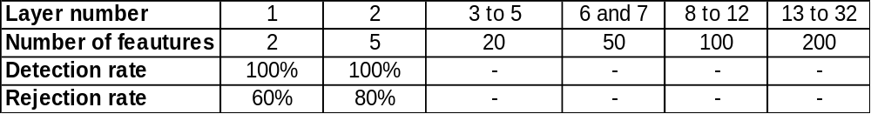

Slide 48
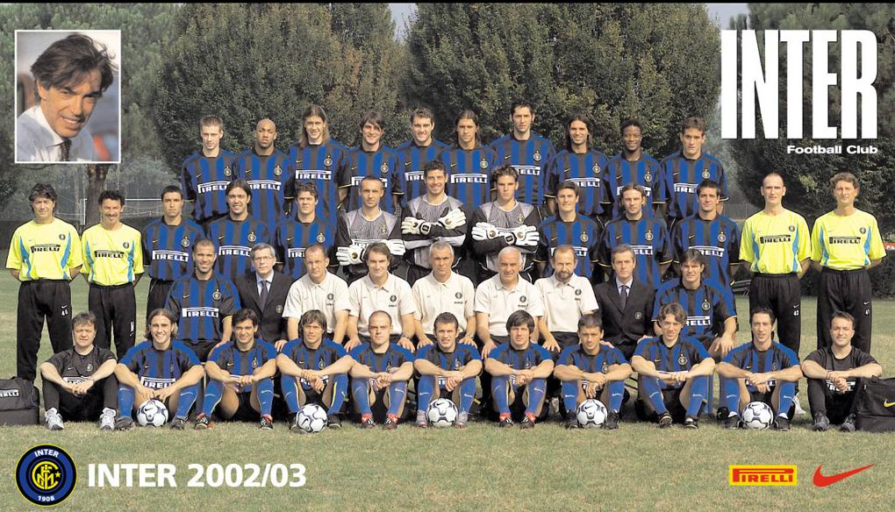
Detection system—scan all the position
How to use the classifier？

Slide 49

Scan all the windows with different size

Slide 50
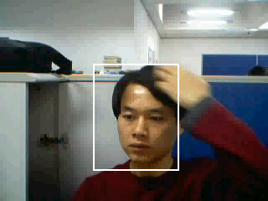
Real time face detection

Slide 51
Generalization Performance
How can we be sure of the generalization performance of a trained classifier, that is, its performance on previously unseen data?
Simple Validation: Divide the dataset D into a training subset and a validation subset. Train on the training set, and evaluate the performance on the validation (test) set. We make sure that no instance of the validation set appears in the training set.

Slide 52
Cross-Validation
Divide the entire dataset D consisting of N instances into M disjoint (mutually exclusive) sets of equal size, N/M
Call each of these M datasets, hold-out sets.
Train the classifier M times, with the entire dataset, minus one of the hold-out sets.
Test each classifier on its own hold-out test. This gives M error rates, or M generalization performance

Slide 53
Cross-Validation
The mean of M generalization performances is considered as a good estimate of the true generalization performance of the classifier.
In the limiting case of N=M, cross validation is equivalent to leave-one-out procedure (Jackknife estimate of the generalization performance).
Cross validation can be used with any classification algorithm !
Notes:
stacking

